Slide 1
Design and Analysis of Algorithms
Back-Tracking Algorithms Part III

Slide 2
Design and Analysis of Algorithms
Back-Tracking Algorithms
Topics:
0/1 Knapsack problem

Slide 3
Simple Review
Subset-sum problem
  The form of solution, State space tree
  Bound function
  Original recursive algorithm
  Improved recursive algorithm
0-1 Knapsack Problem
  The form of solution, State space tree
  Bound function

Slide 4
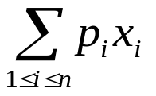
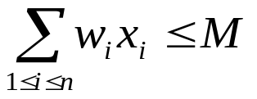
0-1 knapsack problem
0-1 knapsack problem
  0-1 knapsack problem: A thief robs a store and finds n items, with item i being worth $p_{i} and having weight w_{i} pounds, The thief can carry at most M ∈ N in his knapsack but he wants to take as valuable a load as possible. Which item should he take?
  i.e., is maximized and s.t.
The form of solution
  A solution is defined as an n-tuple (x₁，x₂，… ，x_{n}), where x_{i}∈{0，1}, 1≤i≤n. If item i is taken, then x_{i}＝1, otherwise x_{i}＝0.
An optimization problem : we will find a best answer rather than feasible answer.

Slide 5
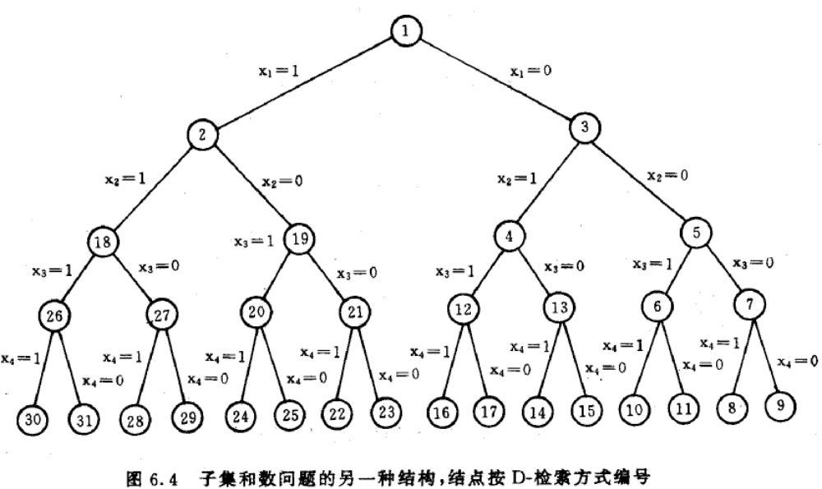
State space tree for 0-1 knapsack problem
It is easy to determine X(i)/generate problem state.
The key is the bound function.

Slide 6
Bound function
Principle: bound function should be helpful to kill some alive nodes.
Our goal is to get max profit, so the bound function should kill those who can not generate greater profit.
Bound function: B(X(1),…, X(k))=true
Iff the profit returned by the method described in the right is greater than the profit gained now.
up-bound of profit on node Z:
Items have been sorted in decreasing order on P(i)/W(i).
On node Z, we have determined the value of X(i), 1≤i ≤k; then for k+1≤i ≤n, relax X(i)=0 or 1 to 0≤X(i) ≤1, use greedy paradigm to solve the relaxed sub-problem.

Slide 7
Bound function
the value of X(i), 1≤i ≤k have been determined.
p: profit gained before call
w: weight used before call
k: item being checked just now
M: knapsack capacity
return the up-bound profit value (items are sorted in decreasing order on P(i)/W(i)).
BOUND
BOUND( p,w,k,M )
b←p; c←w
for i←k+1 to n do
c←c+W(i)
if c<M then b←b+P(i)
else return (b+(1-(c-M)/W(i))*P(i))
return (b)

Slide 8
Bound function
BOUND
BOUND( p,w,k,M )
b←p; c←w
for i←k+1 to n do
c←c+W(i)
if c<M then b←b+P(i)
else return (b+(1-(c-M)/W(i))*P(i))
return (b)
b: profit gained
c: weight used

Slide 9
Bound function
Determine up-bound using greedy algorithm: check item k+1~n one by one, place all the item into the knapsack if possible, otherwise place part of it into.
BOUND
BOUND( p,w,k,M )
b←p; c←w
for i←k+1 to n do
c←c+W(i)
if c<M then b←b+P(i)
else return (b+(1-(c-M)/W(i))*P(i))
return (b)

Slide 10
Bound function
The up-bound on the left son of node Z is same as that on Z.
Need not to call BOUND when traveling to left son.
Back Tracking paradigm always travels to left son rather than right son when possible, so the first call to BOUND occurs after some shifts to left son.

Slide 11
Back Tracking Algorithm for 0-1 knapsack problem
BKNAP1
BKNAP1( M,n,W,P,fw,fp,X )
cw←cp←0;k←1;fp←-1
loop
while k≤ n and cw+W(k) ≤ M do
cw←cw+W(k);cp←cp+P(k);Y(k)←1;k←k+1
if k>n then fp←cp;fw←cw;k←n;X←Y
else Y(k)←0
while BOUND(cp,cw,k,M) ≤ fp do
while k≠0 and Y(k)≠1 do
k←k-1
if k=0 then return
Y(k)←0;cw←cw-W(k);cp←cp-P(k)
k←k+1

Slide 12
Back Tracking Algorithm for 0-1 knapsack problem
M: knapsack capacity
n items, weight and profit of each item are stored in W(1:n) and P(1:n), P(i)/W(i)≥P(i+1)/W(i+1);
fw: weight used eventually
fp: profit gained eventually
X: answer vector
BKNAP1
BKNAP1( M,n,W,P,fw,fp,X )
cw←cp←0;k←1;fp←-1
loop
while k≤ n and cw+W(k) ≤ M do
cw←cw+W(k);cp←cp+P(k);Y(k)←1;k←k+1
if k>n then fp←cp;fw←cw;k←n;X←Y
else Y(k)←0
while BOUND(cp,cw,k,M) ≤ fp do
while k≠0 and Y(k)≠1 do
k←k-1
if k=0 then return
Y(k)←0;cw←cw-W(k);cp←cp-P(k)
k←k+1

Slide 13
Back Tracking Algorithm for 0-1 knapsack problem
BKNAP1
BKNAP1( M,n,W,P,fw,fp,X )
cw←cp←0;k←1;fp←-1
loop
while k≤ n and cw+W(k) ≤ M do
cw←cw+W(k);cp←cp+P(k);Y(k)←1;k←k+1
if k>n then fp←cp;fw←cw;k←n;X←Y
else Y(k)←0
while BOUND(cp,cw,k,M) ≤ fp do
while k≠0 and Y(k)≠1 do
k←k-1
if k=0 then return
Y(k)←0;cw←cw-W(k);cp←cp-P(k)
k←k+1
cw: weight used
cp: profit gained
when fp≠-1, X is the vector that gains profit fp
fw,fp,X: information about the best answer currently found.
cw,cp,Y: corresponding information used when searching.

Slide 14
Back Tracking Algorithm for 0-1 knapsack problem
BKNAP1
Travel to left son when possible, store the path in Y.
BKNAP1( M,n,W,P,fw,fp,X )
cw←cp←0;k←1;fp←-1
loop
while k≤ n and cw+W(k) ≤ M do
cw←cw+W(k);cp←cp+P(k);Y(k)←1;k←k+1
if k>n then fp←cp;fw←cw;k←n;X←Y
else Y(k)←0
while BOUND(cp,cw,k,M) ≤ fp do
while k≠0 and Y(k)≠1 do
k←k-1
if k=0 then return
Y(k)←0;cw←cw-W(k);cp←cp-P(k)
k←k+1
NOTE: BOUND is not used here.

Slide 15
Back Tracking Algorithm for 0-1 knapsack problem
BKNAP1
BKNAP1( M,n,W,P,fw,fp,X )
cw←cp←0;k←1;fp←-1
loop
while k≤ n and cw+W(k) ≤ M do
cw←cw+W(k);cp←cp+P(k);Y(k)←1;k←k+1
if k>n then fp←cp;fw←cw;k←n;X←Y
else Y(k)←0
while BOUND(cp,cw,k,M) ≤ fp do
while k≠0 and Y(k)≠1 do
k←k-1
if k=0 then return
Y(k)←0;cw←cw-W(k);cp←cp-P(k)
k←k+1
if k>n, we get that cp>fp( if cp≤fp, the last call to BOUND will stop the traveling to this leaf), save the answer info.
if k≤n, item k can not be placed into the knapsack, so we must travel to right son( assign 0 to Y(k) ).

Slide 16
Back Tracking Algorithm for 0-1 knapsack problem
BKNAP1
Use BOUND to check that whether a better answer is possible, Track back if not.
BKNAP1( M,n,W,P,fw,fp,X )
cw←cp←0;k←1;fp←-1
loop
while k≤ n and cw+W(k) ≤ M do
cw←cw+W(k);cp←cp+P(k);Y(k)←1;k←k+1
if k>n then fp←cp;fw←cw;k←n;X←Y
else Y(k)←0
while BOUND(cp,cw,k,M) ≤ fp do
while k≠0 and Y(k)≠1 do
k←k-1
if k=0 then return
Y(k)←0;cw←cw-W(k);cp←cp-P(k)
k←k+1
Track back to the nearest node whose right son has not been generated, generate his right son and check by BOUND.
after while ends, we find a better direction, or the procedure terminates.

Slide 17
Back Tracking Algorithm for 0-1 knapsack problem
BKNAP1
BKNAP1( M,n,W,P,fw,fp,X )
cw←cp←0;k←1;fp←-1
loop
while k≤ n and cw+W(k) ≤ M do
cw←cw+W(k);cp←cp+P(k);Y(k)←1;k←k+1
if k>n then fp←cp;fw←cw;k←n;X←Y
else Y(k)←0
while BOUND(cp,cw,k,M) ≤ fp do
while k≠0 and Y(k)≠1 do
k←k-1
if k=0 then return
Y(k)←0;cw←cw-W(k);cp←cp-P(k)
k←k+1
Bound function becomes more and more tighten when searching, for fp becomes greater.

Slide 18
Case Study
M=110,n=8
 | 1 | 2 | 3 | 4 | 5 | 6 | 7 | 8
P | 11 | 21 | 31 | 33 | 43 | 53 | 55 | 65
W | 1 | 11 | 21 | 23 | 33 | 43 | 45 | 55
BKNAP1( M,n,W,P,fw,fp,X )
cw←cp←0;k←1;fp←-1
loop
while k≤ n and cw+W(k) ≤ M do
cw←cw+W(k);cp←cp+P(k);Y(k)←1;k←k+1
if k>n then fp←cp;fw←cw;k←n;X←Y
else Y(k)←0
while BOUND(cp,cw,k,M) ≤ fp do
while k≠0 and Y(k)≠1 do
k←k-1
if k=0 then return
Y(k)←0;cw←cw-W(k);cp←cp-P(k)
k←k+1
fw=101
fp=151
X(1) | X(2) | X(3) | X(4) | X(5) | X(6) | X(7) | X(8)
1 | 1 | 1 | 1 | 1 | 0 | 0 | 0
fw=
fp=-1
fw=89
fp=139
fw=99
fp=149
fw=109
fp=159
X(1) | X(2) | X(3) | X(4) | X(5) | X(6) | X(7) | X(8)
1 | 1 | 1 | 1 | 0 | 0 | 1 | 0
X(1) | X(2) | X(3) | X(4) | X(5) | X(6) | X(7) | X(8)
X(1) | X(2) | X(3) | X(4) | X(5) | X(6) | X(7) | X(8)
1 | 1 | 1 | 1 | 0 | 1 | 0 | 0
X(1) | X(2) | X(3) | X(4) | X(5) | X(6) | X(7) | X(8)
1 | 1 | 1 | 0 | 1 | 1 | 0 | 0
k=8
k=1
k=2
k=3
k=4
k=5
k=6
k=7
k=8
k=9
k=8
k=5
k=6
k=7
k=8
k=9
k=8
k=6
k=7
k=8
k=9
k=7
k=8
k=4
k=5
k=6
k=7
k=8
k=9
k=8
k=6
k=7
k=5
k=3
k=4
k=5
k=6
k=7
k=5
k=4
k=2
k=1
k=0
Y(1)=1
Y(1)=0
1
11
Y(2)=1
Y(2)=0
155.11
12
32
157.44
Y(3)=1
Y(3)=0
33
63
159.76
Y(4)=1
Y(4)=0
Y(4)=1
Y(4)=0
56
96
160.22
35
65
Y(5)=1
Y(5)=0
Y(5)=1
Y(5)=0
Y(5)=1
Y(5)=0
154.88
89
139
162.44
66
106
157.55
68
108
Y(6)=0
Y(6)=1
Y(6)=0
Y(6)=1
Y(6)=0
Y(6)=0
157.11
164.66
99
149
161.63
109
159
159.77
159.33
Y(7)=0
Y(7)=0
Y(7)=1
Y(7)=0
Y(7)=0
158
Y(7)=0
Y(7)=0
163.81
162
159.81
160.18
157.63
101
151
Y(8)=0
Y(8)=0
Y(8)=0
Y(8)=0
Y(8)=0
139
149
151
96
159

Slide 19
Case Study
M=110,n=8
 | 1 | 2 | 3 | 4 | 5 | 6 | 7 | 8
P | 11 | 21 | 31 | 33 | 43 | 53 | 55 | 65
W | 1 | 11 | 21 | 23 | 33 | 43 | 45 | 55
generate 35 of 2⁹－1＝511 nodes of the state space tree
fw=101
fp=151
X(1) | X(2) | X(3) | X(4) | X(5) | X(6) | X(7) | X(8)
1 | 1 | 1 | 1 | 1 | 0 | 0 | 0
fw=
fp=-1
fw=89
fp=139
fw=99
fp=149
fw=109
fp=159
X(1) | X(2) | X(3) | X(4) | X(5) | X(6) | X(7) | X(8)
1 | 1 | 1 | 1 | 0 | 0 | 1 | 0
X(1) | X(2) | X(3) | X(4) | X(5) | X(6) | X(7) | X(8)
X(1) | X(2) | X(3) | X(4) | X(5) | X(6) | X(7) | X(8)
1 | 1 | 1 | 1 | 0 | 1 | 0 | 0
X(1) | X(2) | X(3) | X(4) | X(5) | X(6) | X(7) | X(8)
1 | 1 | 1 | 0 | 1 | 1 | 0 | 0
k=8
k=1
k=2
k=3
k=4
k=5
k=6
k=7
k=8
k=9
k=8
k=5
k=6
k=7
k=8
k=9
k=8
k=6
k=7
k=8
k=9
k=7
k=8
k=4
k=5
k=6
k=7
k=8
k=9
k=8
k=6
k=7
k=5
k=3
k=4
k=5
k=6
k=7
k=5
k=4
k=2
k=1
k=0
Y(1)=1
Y(1)=0
? can we do better
1
11
Y(2)=1
Y(2)=0
all P(i)s are integers, so the answer is integer too. ⎣BOUND(…)⎦ is better.
155.11
12
32
157.44
Y(3)=1
Y(3)=0
33
63
159.76
Y(4)=1
Y(4)=0
Y(4)=1
Y(4)=0
56
96
160.22
35
65
Y(5)=1
Y(5)=0
Y(5)=1
Y(5)=0
Y(5)=1
Y(5)=0
154.88
89
139
162.44
66
106
157.55
68
108
Y(6)=0
Y(6)=1
Y(6)=0
Y(6)=1
Y(6)=0
Y(6)=0
157.11
164.66
99
149
161.63
109
159
159.77
159.33
Y(7)=0
Y(7)=0
Y(7)=1
Y(7)=0
Y(7)=0
158
Y(7)=0
Y(7)=0
163.81
162
159.81
160.18
157.63
101
151
Y(8)=0
Y(8)=0
Y(8)=0
Y(8)=0
Y(8)=0
139
149
151
96
159

Slide 20
Homework
Solve the following 0-1 knapsack problem use the algorithm discussed today, try to draw the tree generated.
  n=3，M=22，(p₁,p₂,p₃)=(30,18,17)， (w₁,w₂,w₃)=(15,10,10)

